Slide 1
Starting the Jupyter Notebook
Once you have installed Anaconda, you can start the Jupyter notebook
Either
search for Jupyter in your applications menu, or
open up a terminal and type Jupyter Notebook
Windows users should substitute “Anaconda command prompt” for “terminal” in the previous line

Slide 2
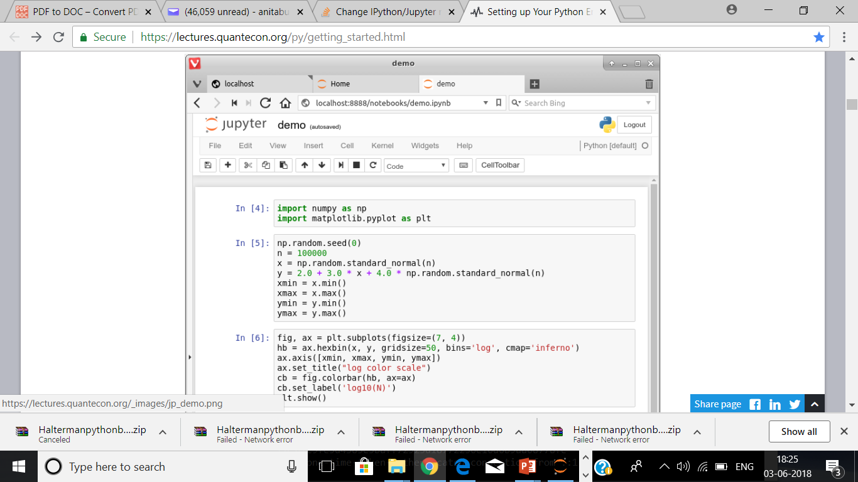
The Jupyter will run in browser

Slide 3
The default browser opens up with a web page.
The output tells us the notebook is running at http://localhost:8888
Localhost is the name of the local machine
8888 referes to port number of the computer
Thus, the Jupyter kernel is listening for Python commands on port 8888 of our local machine.

Slide 4
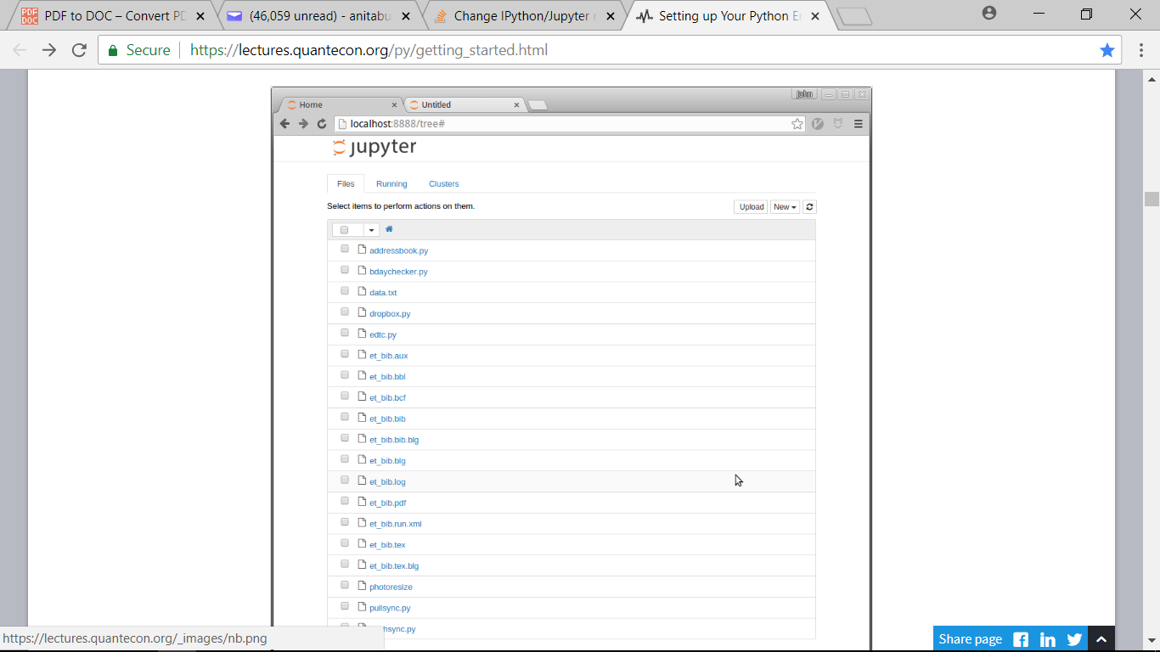
Jupyter dashboard

Slide 5
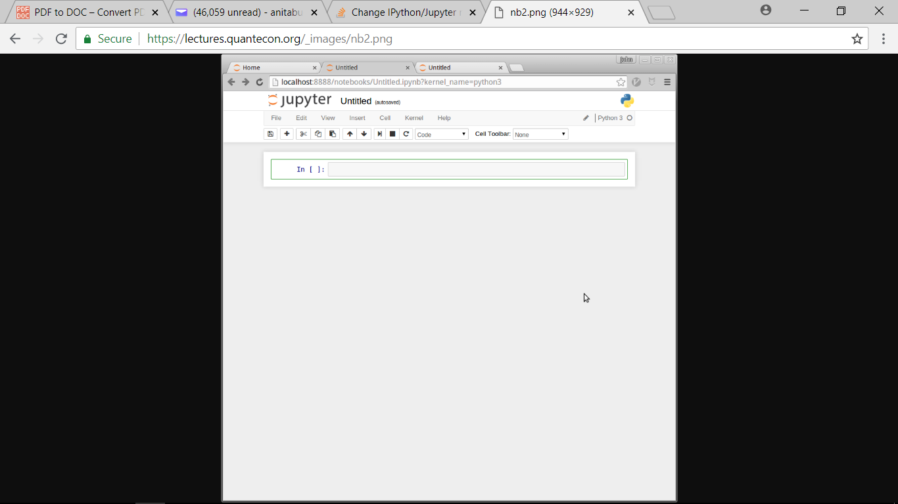
Click New and Select Python3 to see the an active cell to type Python commands :

Slide 6
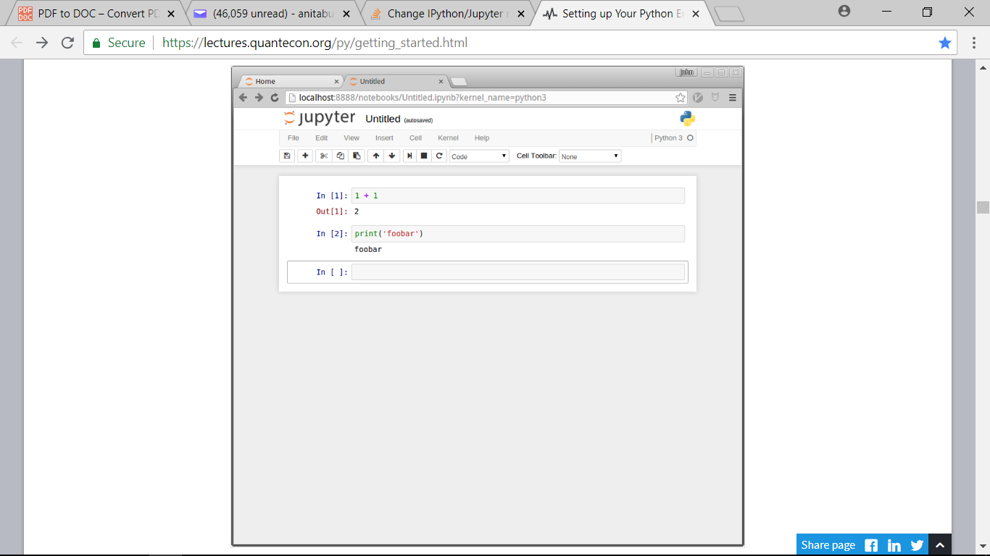
Running Cells

Slide 7
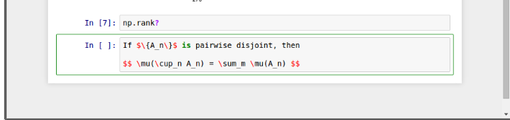
Other Content In addition to executing code, the Jupyter notebook allows you to embed text, equations, figures and even videos in the page. Next press Esc to enter command mode and press m to indicate that you are writing Markdown, a markup language similar to Latex, or use dropdown to select Markdown box just below the list of menu items.

Slide 8
Modal Editing
Modal Editing means that the effect of typing at the keyboard depends on which mode you are in:
The two modes are
This means that the effect of typing at the keyboard depends on which mode you are in:
The two modes are:
Edit Mode:
Indicated by a green border around the cell
Whatever you type appears as in the cell
Command Mode:
The green border is replaced by grey border
Keystrokes are interpreted as commands: example typing b adds a new cell below the current one
To switch between the two modes
to command mode from edit mode, press Esc key or CTRL M
To edit mode from command mode, hit enter or click on a cell
The modal behavior of the Jupyter notebook is a little tricky at first but very efficient when you get used to it

Slide 9
Working with the Notebook
Example
Import numpy as np (NumPy is a numerical library we’ll work with in depth)
After this import command, functions in NumPy can be accessed with
np.functionname
Example np.random.randn(3)
After typin np.ran press tab
Jupyter will tell us about all the functions available

Slide 10
On-Line Help
One can get online help on various library functions
Example
To get help on np.rank
write np.rank?
And run the code
Documentation appears in a split window of the browser

Slide 11
Sharing Notebooks
Notebook files are just text files structured in JSON and typically ending with ipynb.
You can share them in the usual way that you share files — or by using web services such as nbviewer.

Slide 12
Updating Anaconda
Anaconda supplies a tool called conda to manage and upgrade your Anaconda packages
One command you should execute regularly is the one that updates the whole Anaconda distribution
As a practice run, please execute the following
Open up a terminal
Type conda update anaconda

Slide 13
How does one run a locally saved Python file?
Option 1: Copy and Paste
Navigate to your file with your mouse / trackpad using a file browser
Click on your file to open it with a text editor
Copy and paste into a cell and Shift+Enter
Method 2: Run
Using the run command is often easier than copy and paste
For example, %run test.py will run the file test.py

Slide 14
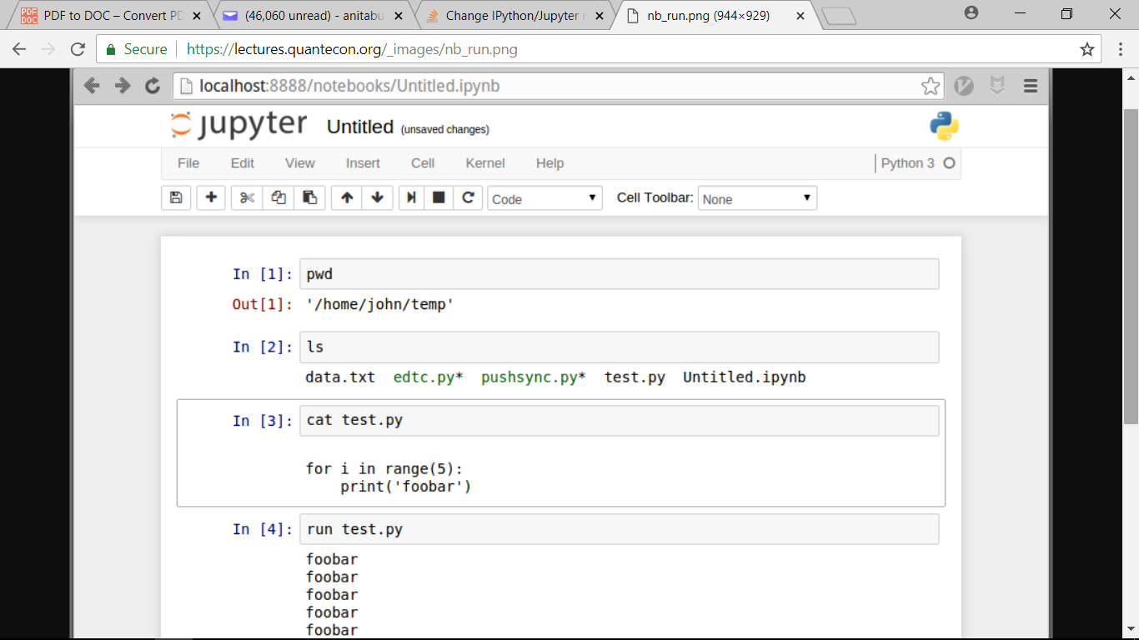
Viewing the Dir and Files from Jupyter

Slide 15
IF the program file is not in your directory?
If you’re trying to run a file not in the present working director, you’ll get an error
To fix this error you need to either
Shift the file into the PWD, or
Change the PWD to where the file lives
One way to achieve the first option is to use the Upload button
The button is on the top level dashboard, where Jupyter first opened
The second option can be achieved using the cd command
Cd c:\python25\scripts

Slide 16
Saving Files
To save the contents of a cell as file prog1.py
Put %%file prog1.py as the first line of the cell
Run the file by button or Shift+Enter
It will save the file as prog1.py in the current path folder
%%file is and example of cell magic

Slide 17
JupyterLab
It is an integrated development environment centered around Jupyter notebooks
It is available through Anaconda and will soon be made the default environment for Jupyter notebooks
Reading the docs or searching for a recent YouTube video will give you more information

Slide 18
Text Editors
A text editor is an application that is specifically designed to work with text files — such as Python programs
Nothing beats the power and efficiency of a good text editor for working with program text
A good text editor will provide
efficient text editing commands (e.g., copy, paste, search and replace)
syntax highlighting, etc.
Among the most popular are Sublime and Atom
For a top quality open source text editor with a steeper learning curve, try Emacs

Slide 19
Text Editors Plus IPython Shell
A text editor is for writing programs
To run them you can continue to use Jupyter as described above
Another option is to use the excellent Ipython Shell
To use an IPython shell, open up a terminal and type
The IPython shell has many of the features of the notebook: tab completion, color syntax, etc.
It also has command history through the arrow key
Run magicfile.py

Slide 20
IDEs
IDEs are Integrated Development Environments, which allow you to edit, execute and interact with code from an integrated environment
One of the most popular in recent times is VS Code, which is
Now available via anaconda

Slide 21
Exercise 1
If Jupyter is still running, quit by using ctrl C at the terminal where you started it
Now launch again, but this time using
Jupyter notebokk - - no-browser
This should start the kernel without launching the browser
Now Start your browser — or open a new tab if it’s already running
Enter the URL from above (e.g. http://localhost/:8888) in the address
You should now be able to run a standard Jupyter notebook session
This is an alternative way to start the notebook that can also be handy

